Slide 1
Constraint Satisfaction
CS161
Guy Van den Broeck

Slide 2
Constraint Satisfaction Problems
What? n-queens, cryptoarithmetic, map coloring, SAT, etc.
Factored problem formulation
Look inside state structure (no longer black box)
Representation (formal language)
Variables X
Domains D
Constraints (=goal test)
More powerful general-purpose solvers

Slide 3
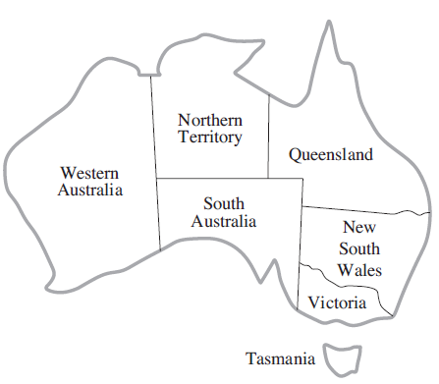

Example: Graph Coloring

Slide 4
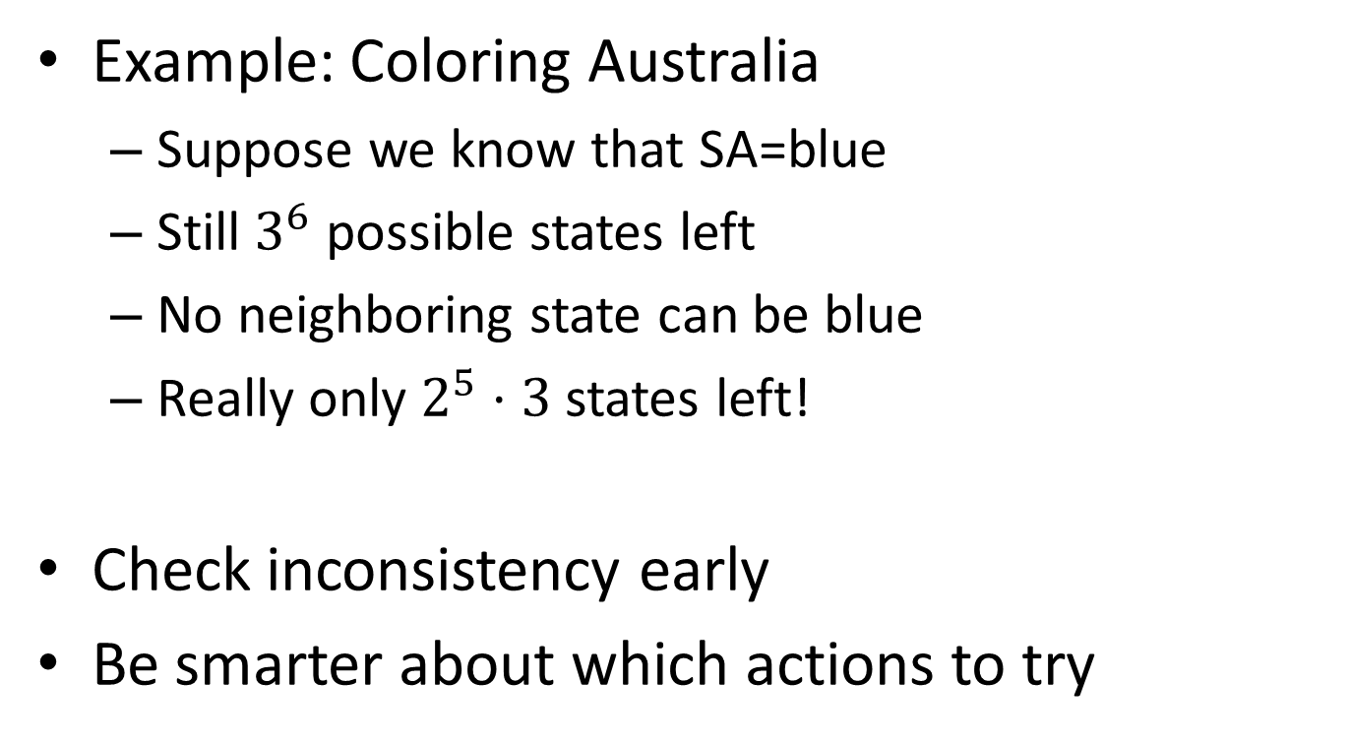
What is the benefit of a factorized representation?

Slide 5
Constraint Satisfaction Problems
Constraint types
Unary
Binary
Higher-order
Global constraints
Soft constraints
Linear/Mathematical programming

Slide 6
Examples
Cryptarithmetic
SAT solving

Slide 7
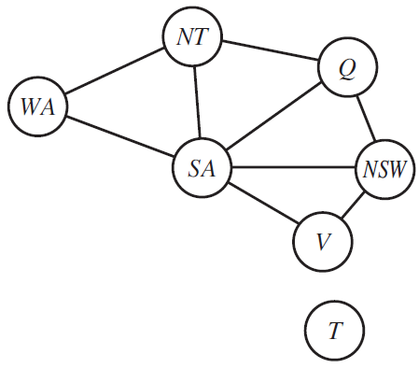
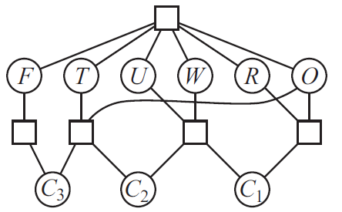
Constraint graphs
Binary constraints: Binary constraint graphs
Higher-order constraints: Constraint hypergraphs/ bipartite graphs

Slide 8
Real-World Examples
Assignment problems (who teaches this class)
Timetabling problems (when and where)
Hardware configuration
Transportation scheduling
Factory scheduling
Floorplanning
Etc.

Slide 9
CSP Search, the Naïve Way
Initial state: empty assignment {}
Actions: assign to a variable X a value v
Any choice of unassigned X
Any choice of v
Only allowed if no constraint becomes violated
Successor function: add {X=v} to state
Goal test:
all variables get assignment, and
all constraints are satisfied

Slide 10
CSP Search, the Naïve Way
Search tree
Which search algorithm to use?

Slide 11
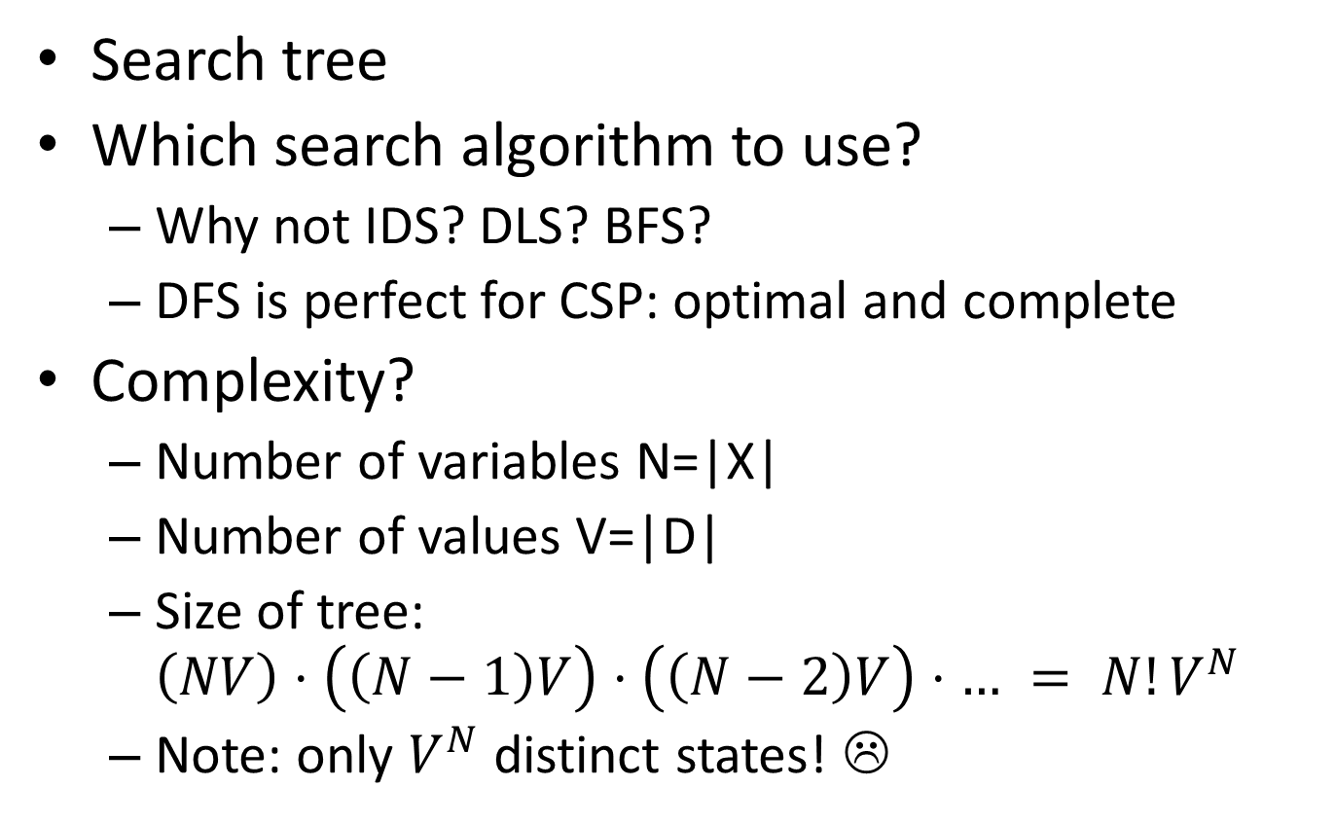
CSP Search, the Naïve Way

Slide 12
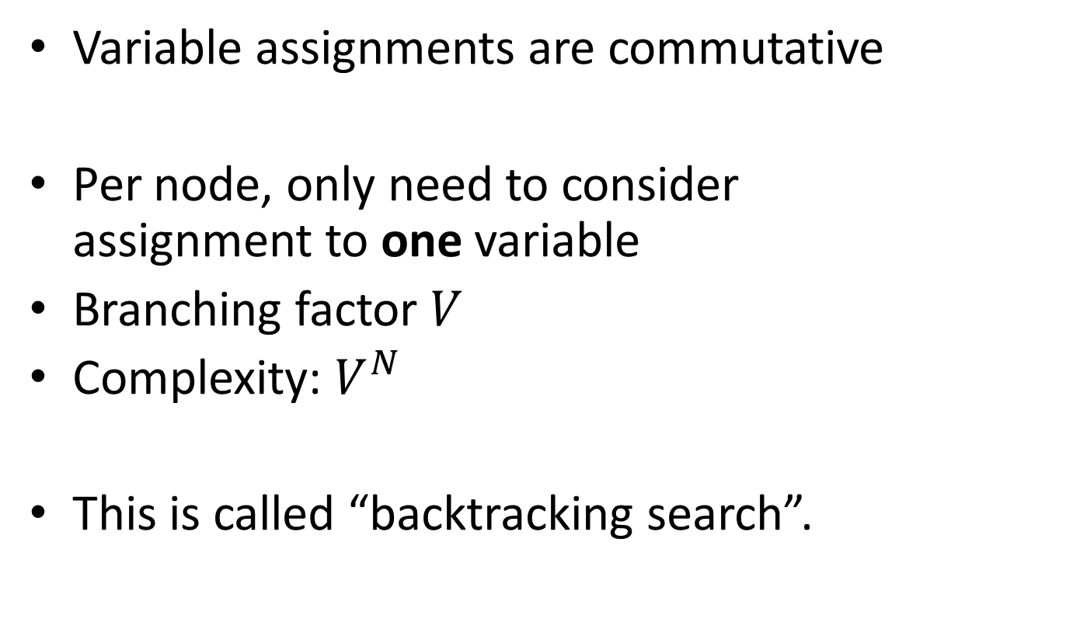
Can we do better?

Slide 13
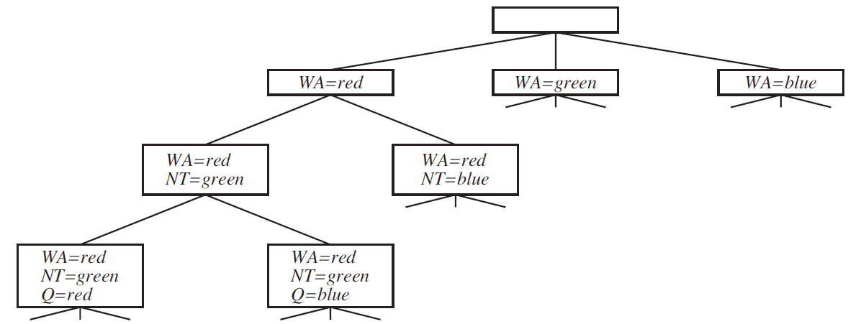
Backtracking Search

Slide 14
Improvements?
Which variable next?
Which value next?
Detect inevitable failure early
Exploit problem structure

Slide 15
Effect of Variable Order?
Constraints: X=Y, Y=Z
Constraint graph: X – Y – Z
Which order to pick?
Order A: XZY
Order B: XYZ
Variable order permutes the tree and changes its size!

Slide 16
Example

Slide 17
Variable Selection Heuristics
Note: not a “heuristic” as in heuristic search
General idea: first-fail principle
Most constrained variable heuristic: Pick variable with fewest legal values
aka Minimum remaining values heuristic
Reduces branching factor immediately

Slide 18
Example

Slide 19
Variable Selection Heuristics
Note: not a “heuristic” as in heuristic search
General idea: first-fail principle
Degree heuristic: Pick variable with most constraints on remaining variables
Tie-breaker among most constrained variables
Easily computed on constraint graph (how?)
Reduces branching factor further down

Slide 20
Value Selection Heuristics
?

Slide 21
Value Selection Heuristics
Note: not a “heuristic” as in heuristic search
Least constraining value heuristic: Pick value ruling out fewest values in remaining variables
Combined with variable heuristics: 1000-queens feasible

Slide 22
Is there something wrong?
Most constrained variable
Least constraining value
Are these contradicting?
What if there is no solution?

Slide 23
Detect Failure Early
Idea:
keep track of remaining legal values for all variables
stop search when some variable has no more legal values
Forward Checking algorithm

Slide 24
Detect Failure Even Earlier
Idea:
keep track of remaining legal values for all variables
stop search when some variable has no more legal values
Arc Consistency algorithm

Slide 25
3 levels of conflict detection
check constraints
check constraint for (X,Y) after making assignment to both X and Y
forward checking
remove possible values for Y after assigning a value to X
arc consistency
propagate forward checking throughout constraint graph

Slide 26
Complexity of Maintaining Arc Consistency
Assume a binary CSP, which has at most O(n²) edges
Arc consistency can be run on each arc (X,Y) at most d times, where d is number of values in domain … because each run is triggered by 1 value removed
Checking consistency of one arc costs O(d²) .... because 2 nested for loops
Complexity is in O(n² * d * d²) = O(n²d³)

Slide 27
Structure

Slide 28
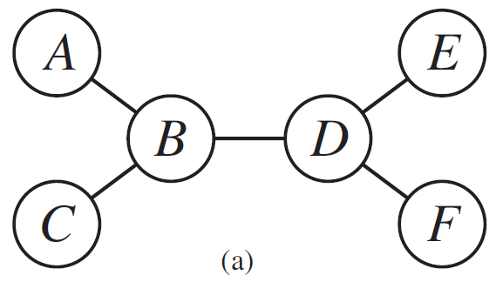
Structure: Tree

Slide 29
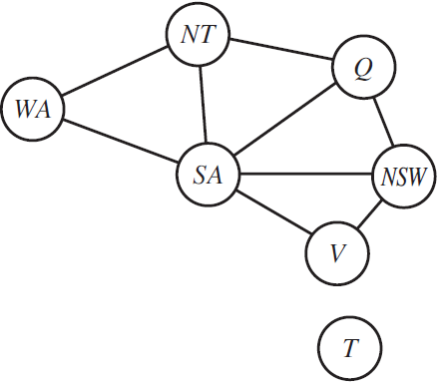
Structure?

Slide 30
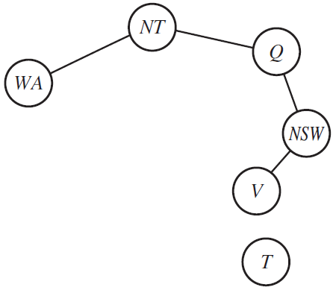
Structure: Cutset Conditioning

Slide 31
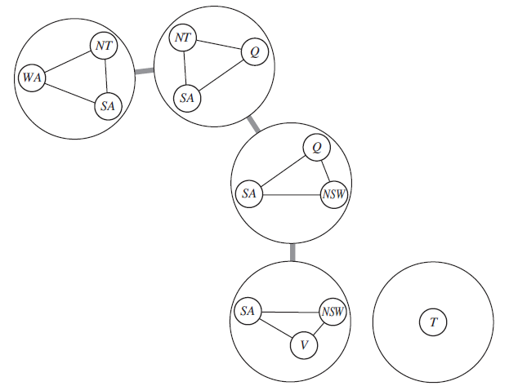
Structure: Tree Decomposition

Slide 32
Problem Structure
Similar insights will be important later for
SAT solving
Computing probabilities in Bayesian networks
Find a graph abstraction, then exploit its sparsity in your algorithm.

